Slide 1
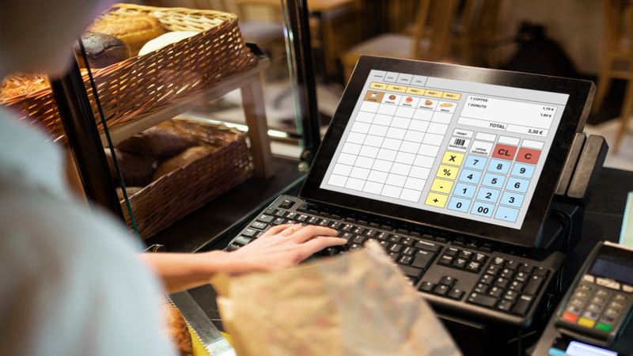
Canteen Pre-Order System
SUBMITTED BY :
ROSHAN BRIGHT R 240701439

Slide 2
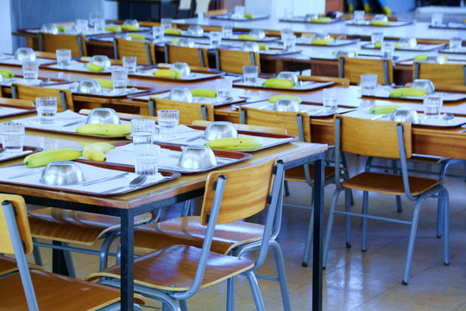
INTRODUCTION
The Canteen Pre-Order System is a technology-based system that enables customers to place orders for food in advance using a web or mobile application. The system eliminates queues, waiting time, and mistakes that occur during peak hours. The system enables canteen management to handle orders effectively and reduces food wastage. In general, the system enhances convenience, speed, and efficiency for customers and canteen management.

Slide 3
PROBLEM STATEMENT
The Traditional Canteen Management System in educational institutions and organizations is primarily dependent on manual systems, resulting in long queues, delays, and low service quality. The lack of a Pre-Order System causes customers to wait during peak times, resulting in congestion and low convenience levels. Moreover, the lack of Digital Ordering makes it difficult for canteen management to monitor orders, track inventory, and process payments. The above-mentioned problems and challenges clearly indicate the need for a more efficient and modern digital system that would allow customers to pre-order their food, make cashless payments, and monitor orders in real time.

Slide 4

ABSTRACT
The Canteen Pre-Order System is a digital platform designed to improve the efficiency and convenience of food ordering in institutional canteens. The traditional manual system often results in long queues, time wastage, and order inaccuracies, especially during peak hours. This system allows users to view menus, place orders in advance, and select preferred pickup times using a web or mobile application.
The system enhances operational efficiency for canteen management by organizing orders systematically, enabling better demand forecasting, and reducing food wastage. It also supports cashless transactions, which minimizes manual errors and speeds up the payment process. Real-time order updates help staff manage preparation and delivery more effectively.
Overall, the Canteen Pre-Order System improves customer satisfaction by reducing waiting time and ensuring timely food availability. It provides a reliable, user-friendly, and scalable solution that modernizes canteen operations and delivers a smoother food service experience.

Slide 5

Existing System -Uses
In the existing canteen system, food ordering is done manually at the counter. Customers physically visit the canteen, check the available menu, and place orders directly with the staff. Payments are usually made in cash or through basic digital methods. The system is mainly used for immediate, on-the-spot food preparation and serving. Canteen staff use verbal communication or handwritten notes to manage orders and prepare food accordingly. This system is simple to operate and does not require advanced technology. It is commonly used in small institutions where the number of customers is limited. However, it becomes inefficient during peak hours due to long queues, delayed service, and lack of proper order tracking.

Slide 6

EXISTING SYSTEM - DRAWBACKS
Long waiting queues and overcrowding during peak hours cause time wastage and inconvenience for customers.
Manual order handling leads to errors, miscommunication, and difficulty in tracking orders efficiently.
Lack of advance planning results in poor inventory management, food wastage, and reduced service efficiency.

Slide 7

PROPOSED SYSTEM
The proposed system is called Canteen Pre-Order System. The system enables customers to place orders for food in advance using a web or mobile application.
The system offers online menu display, cashless payment systems, and live order tracking for improved transparency and convenience.
The proposed system enables canteen staff to manage orders effectively, prepare food accordingly, minimize food wastage, and optimize overall service delivery.

Slide 8
LITERATURE SURVEY
S.No | Author Name | Year of Publish | Title of Paper | Technology / Algorithm / Tools Used | Drawback in Existing System
1 | P. K. Sinha, R. Verma | 2021 | Smart Canteen and Cafeteria Management System Using RFID | RFID, IoT, Embedded System | High implementation cost and hardware dependency
2 | A. Sharma, S. Patel | 2020 | Mobile Based Food Ordering System for Smart Canteens | Android App, Firebase Database | Requires stable internet connection
3 | N. Jain, V. Gupta | 2019 | Online Food Ordering System Using Android Application | Android Studio, Java, MySQL | Limited scalability and less security features

Slide 9
5 | S. Kumar, D. Singh | 2021 | Cloud Based Food Ordering and Management System | Cloud Computing, Web Application, Database Server | Data privacy and cloud storage security concerns
4 | M. Rahman, T. Islam | 2022 | QR Code Based Smart Canteen Ordering System | QR Code Technology, Web Application | QR dependency may fail if scanning errors occur
6 | L. Fernandez, K. Roy | 2018 | Queue Management System for Canteen Using Mobile App | Token Algorithm, Mobile Application | Cannot handle peak time heavy traffic efficiently

Slide 10
7 | H. Chen, Y. Lee | 2020 | Web Based Smart Food Court Ordering System | Web Technology, PHP, JavaScript, MySQL | Limited offline functionality
8 | R. Mehta, P. Shah | 2019 | Automated Canteen Ordering System Using RFID Technology | RFID Card System, Database Management | Card loss or duplication risk
9 | S. Thomas, J. Mathew | 2022 | E-Canteen: Online Food Pre-Ordering System | Web Portal, Payment Gateway Integration | Payment failure and transaction delay issues
10 | K. Banerjee, A. Dutta | 2023 | AI Based Food Recommendation and Ordering System | Artificial Intelligence, Machine Learning, Data Analytics | Requires large dataset for accurate recommendation

Slide 11
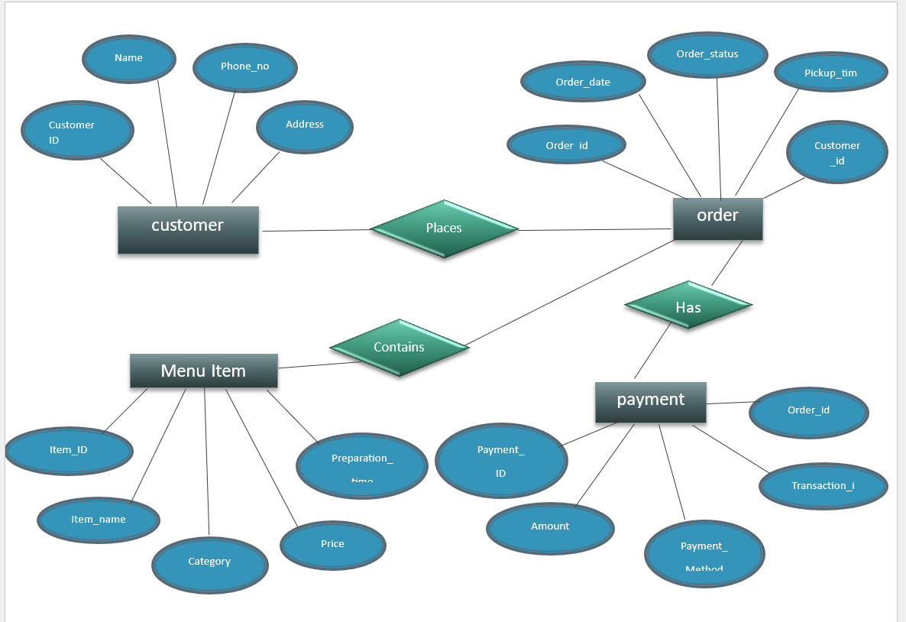
ER DIAGRAM

Slide 12
Functional Requirements (FR)
1. User Login & Registration
  Allows users to register and log in using ID, phone number, or email.
  Supports different roles such as Admin, Canteen Staff, and Customer.
2. Menu Management
  Admin can add, update, or remove food items.
  Each item includes name, price, image, availability, and category.
3. View Menu & Availability
  Users can view the food menu.
  Shows available / unavailable food items in real time.
4. Food Preorder
  Users can select food items and place orders in advance.
  Allows selecting quantity and pickup time.
5. Order Confirmation
  System generates order ID after successful order.
  Displays order summary and total amount.

Slide 13
6. Payment Processing
  Supports online payment / cash on pickup (as configured)
  Confirms payment status for each order.
7. Order Status Tracking
  Users can track order status:
    Pending
    Preparing
    Ready for Pickup
8. Order History
  Users can view previous orders and order details.
  Helps in reordering frequently used items.
9. Notifications & Alerts
  Sends notifications for:
    Order confirmation
    Order ready message
    Order cancellation
10. Admin Reports
  Admin can view daily sales, popular items, and total orders.
  Helps in inventory and food planning.

Slide 14
Non-Functional Requirements (NFR)
1. Performance
  The system should load menus and place orders within a few seconds.
  Works smoothly during peak hours (break/lunch time).
2. Security
  User data and payment details must be securely stored.
  Only authorized users can access admin features.
3. Reliability
  System should work without crashing.
  Orders must not be lost during processing.
4. Availability
  System should be available during canteen working hours.
  Minimal downtime.
5. Usability
  Interface should be simple and easy to use.
  Clear buttons, readable text, and simple navigation.

Slide 15
6. Scalability
  System should handle more users and orders in future.
  Supports menu expansion without redesign.
7. Maintainability
  Easy to update menu items, prices, and offers.
  Simple maintenance and bug fixing.
8. Data Accuracy
  Ensures correct order details and billing.
  Prevents duplicate orders.
9. Compatibility
  Works on mobile phones, tablets, and desktops.
  Supports common browsers.
10. Backup & Recovery
  System should regularly backup order and user data.
  Allows data recovery in case of failure.

Slide 16
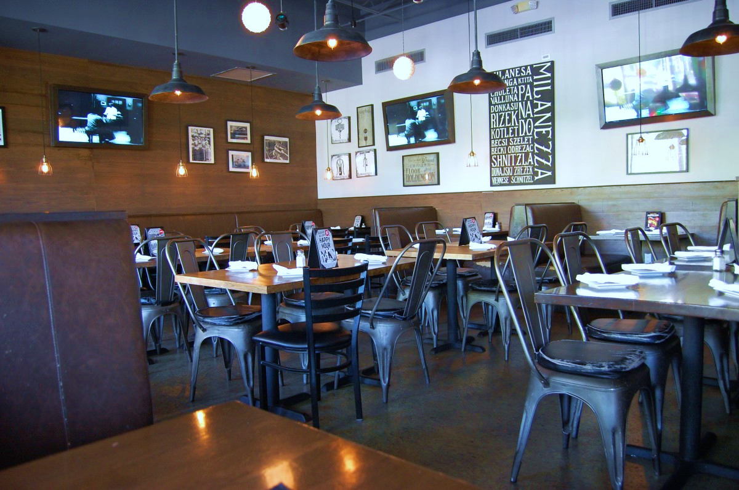
THANK YOU

